Slide 1
Evaluation
Rong Jin

Slide 2
Evaluation
Evaluation is key to building effective and efficient search engines
  usually carried out in controlled experiments
  online testing can also be done
Effectiveness and efficiency are related
  High efficiency may be obtained at the price of effectiveness

Slide 3
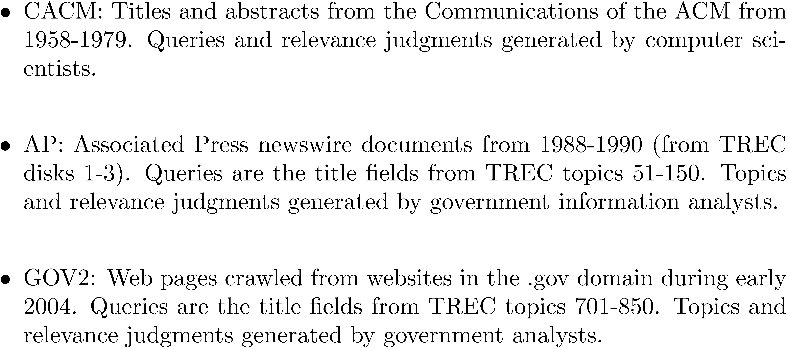
Evaluation Corpus
Test collections consisting of documents, queries, and relevance judgments, e.g.,

Slide 4
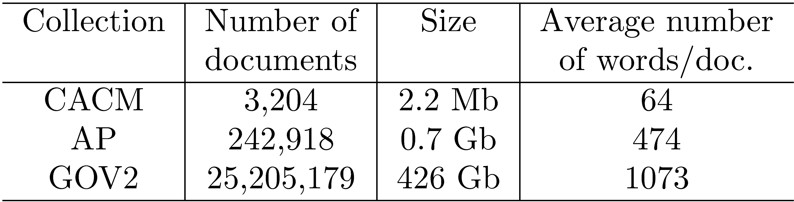
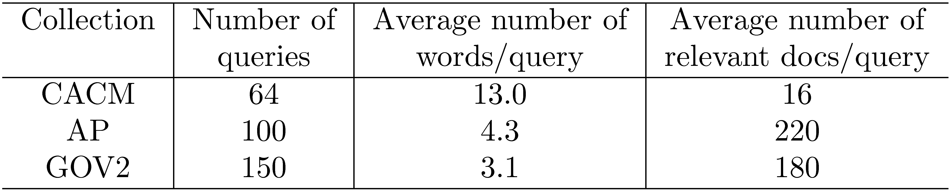
Test Collections

Slide 5
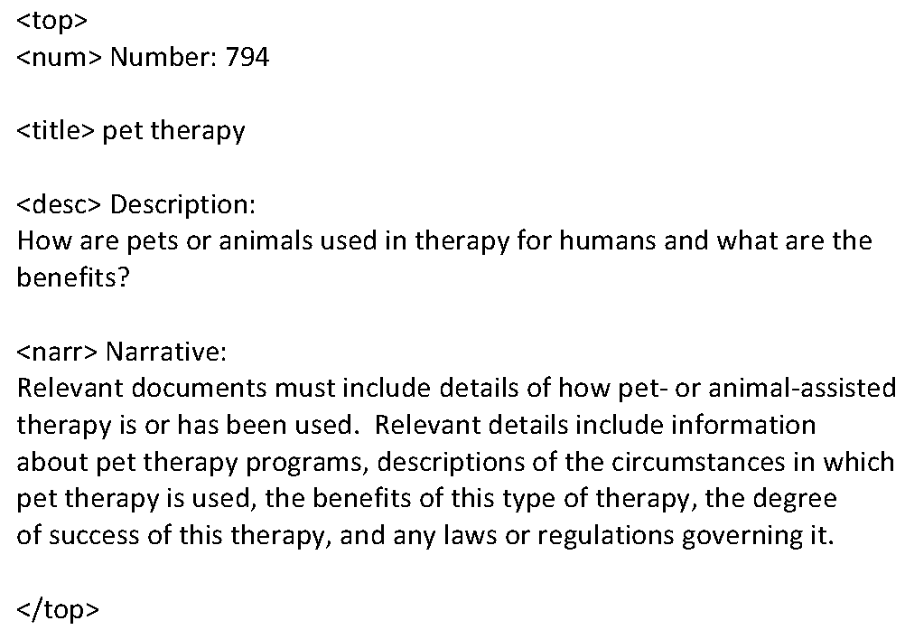
TREC Topic Example

Slide 6
Relevance Judgments
Obtaining relevance judgments is an expensive, time-consuming process
  who does it?
  what are the instructions?
  what is the level of agreement?
TREC judgments
  depend on task being evaluated
  generally binary
  reasonable agreement because of “narrative”

Slide 7
Pooling
Exhaustive judgments for all documents in a collection is not practical
Pooling technique is used in TREC
  top k results (k varied between 50 and 200) from the rankings obtained by different search engines are merged into a pool
  duplicates are removed
  documents are presented in some random order to the relevance judges
Produces a large number of relevance judgments for each query, although still incomplete

Slide 8
Pooling
d1
Query
d2
d13
To be judged
Search engine 1
Search engine 2
Search engine 3
d43
d1
d2
d43
d2
d1
d13
d75
d100
d75
d501
d75
d100
d75
d100
1,000,000 docs
d501

Slide 9
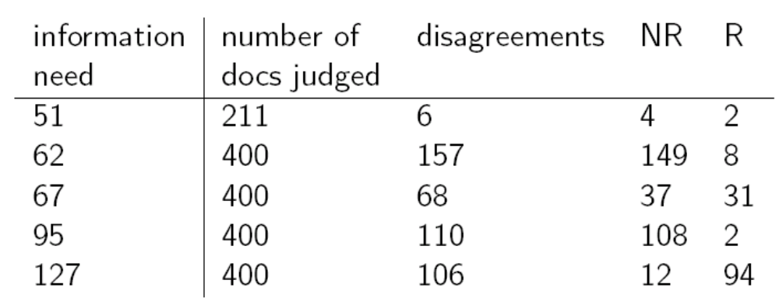
Bias in Relevance Judgments
Relevance judgment is subjective
Disagreement among assessors

Slide 10
Combine Multiple Judgments
Judges disagree a lot. How to combine judgments from multiple reviewers ?
  Union
  Intersection
  Majority vote

Slide 11
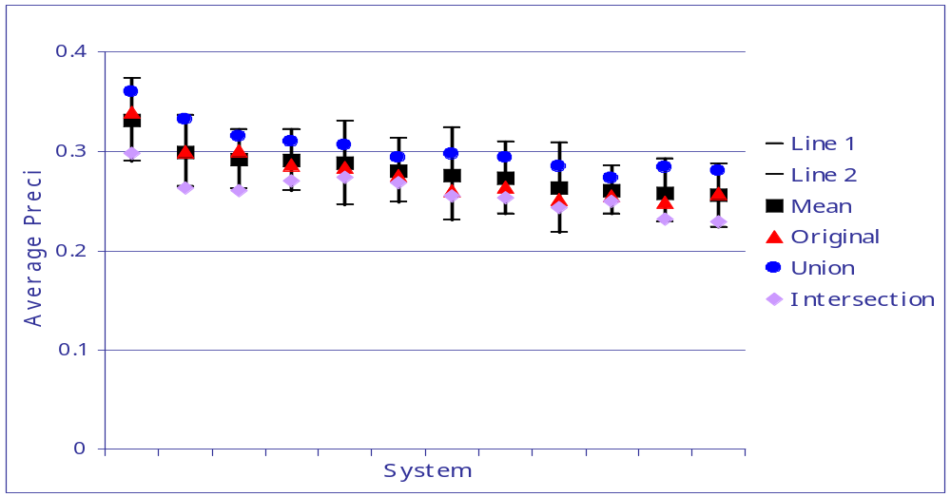
Combine Multiple Judgments
Large impact on absolute performance numbers
Virtually no impact on ranking of systems

Slide 12
Query Logs
Used for tuning and evaluating search engines
  also for techniques such as query suggestion and spell checking
Typical contents
  User identifier or user session identifier
  Query terms - stored exactly as user entered
  List of URLs of results, their ranks on the result list, and whether they were clicked on
  Timestamp(s) - records the time of user events such as query submission, clicks

Slide 13
Query Logs
Clicks are not relevance judgments
  although they are correlated
  biased by a number of factors such as rank on result list
Can use clickthough data to predict preferences between pairs of documents
  appropriate for tasks with multiple levels of relevance, focused on user relevance
  various “policies” used to generate preferences

Slide 14
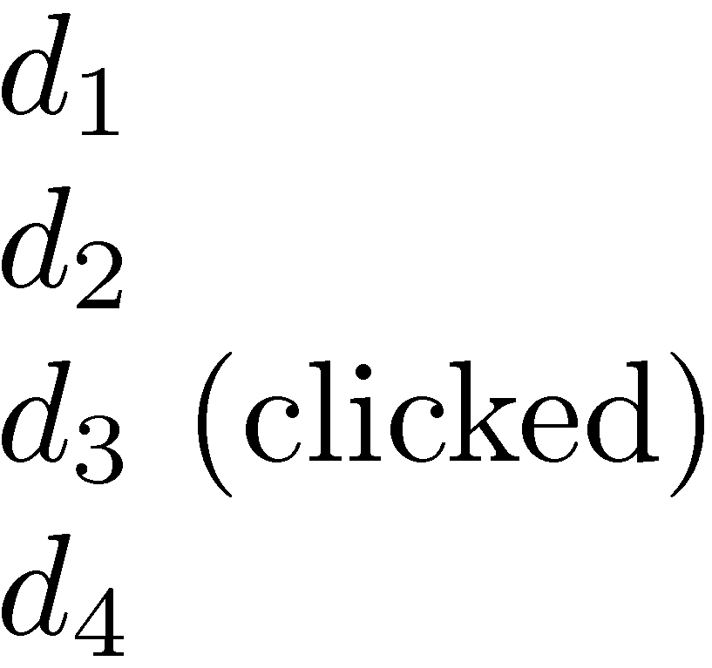
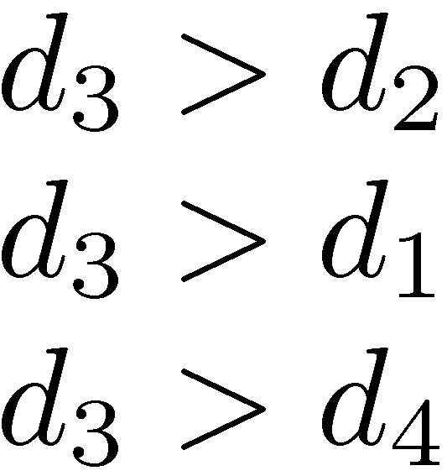
Example Click Policy
Skip Above and Skip Next
  click data
  generated preferences

Slide 15
Query Logs
Click data can also be aggregated to remove noise
Click distribution information
  can be used to identify clicks that have a higher frequency than would be expected
  high correlation with relevance
  e.g., using click deviation to filter clicks for preference-generation policies

Slide 16
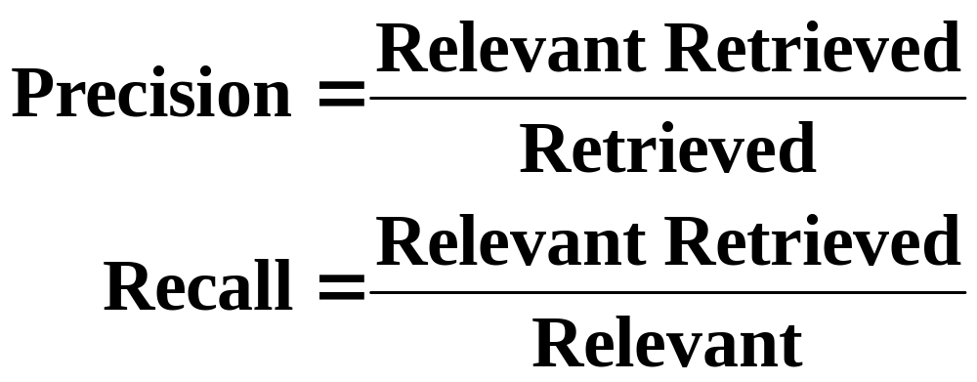
Evaluation Metrics: Classification View
Action
Retrieved
Not Retrieved
Doc
Relevant
Relevant Retrieved
Relevant Rejected
Not relevant
Irrelevant Retrieved
Irrelevant Rejected

Slide 17
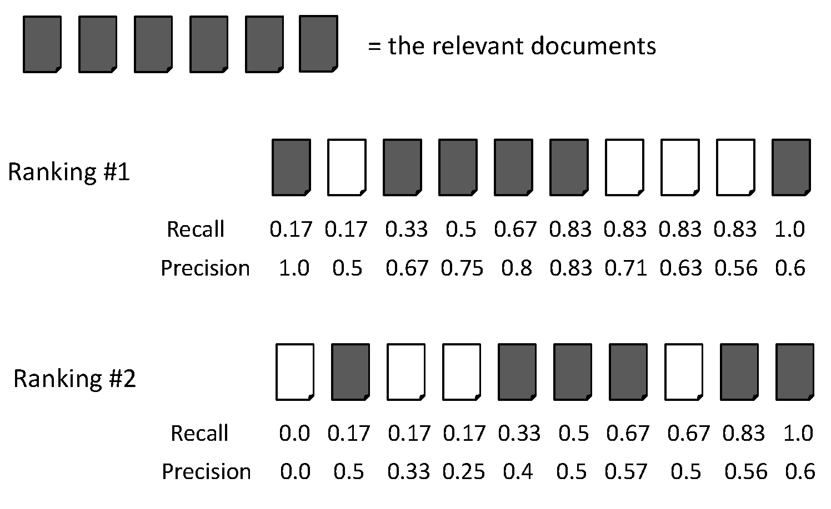
Evaluation Metrics: Example
Recall = 2/6 = 0.33
Precision = 2/3 = 0.67

Slide 18
Evaluation Metrics: Example
Recall = 5/6 = 0.83
Precision = 5/6 = 0.83

Slide 19
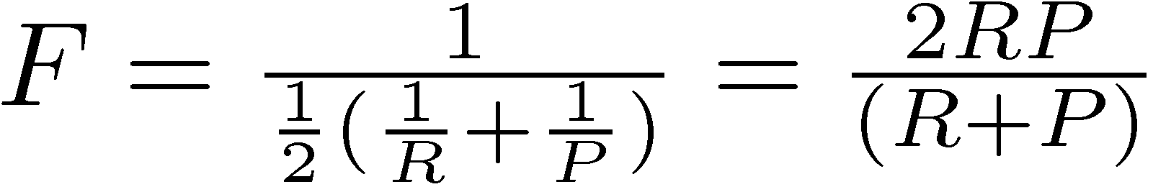
F Measure
Harmonic mean of recall and precision
  Why harmonic mean?
  harmonic mean emphasizes the importance of small values, whereas the arithmetic mean is affected more by outliers that are unusually large

Slide 20
Evaluation Metrics: Example
Recall = 2/6 = 0.33
Precision = 2/3 = 0.67
F = 2*Recall*Precision/(Recall + Precision)
= 2*0.33*0.67/(0.33 + 0.67) = 0.22

Slide 21
Evaluation Metrics: Example
Recall = 5/6 = 0.83
Precision = 5/6 = 0.83
F = 2*Recall*Precision/(Recall + Precision)
= 2*0.83*0.83/(0.83 + 0.83) = 0.83

Slide 22
Evaluation for Ranking
Average precision
  Averaging the precision values from the rank positions where a relevant document was retrieved
  Set precision values to be zero for the not retrieved documents

Slide 23
Average Precision: Example

Slide 24
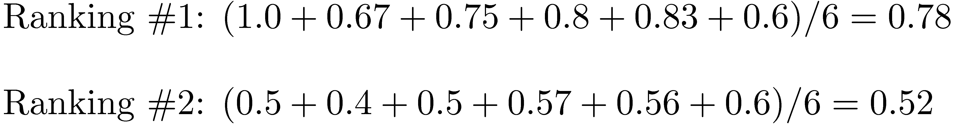
Average Precision: Example

Slide 25
Average Precision: Example

Slide 26
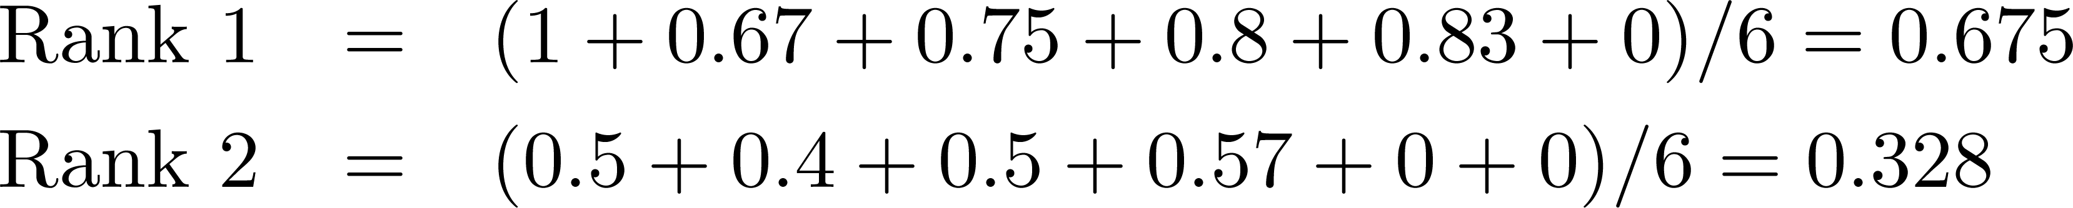
Average Precision: Example
Miss one relevant document

Slide 27
Average Precision: Example
Miss two relevant documents

Slide 28
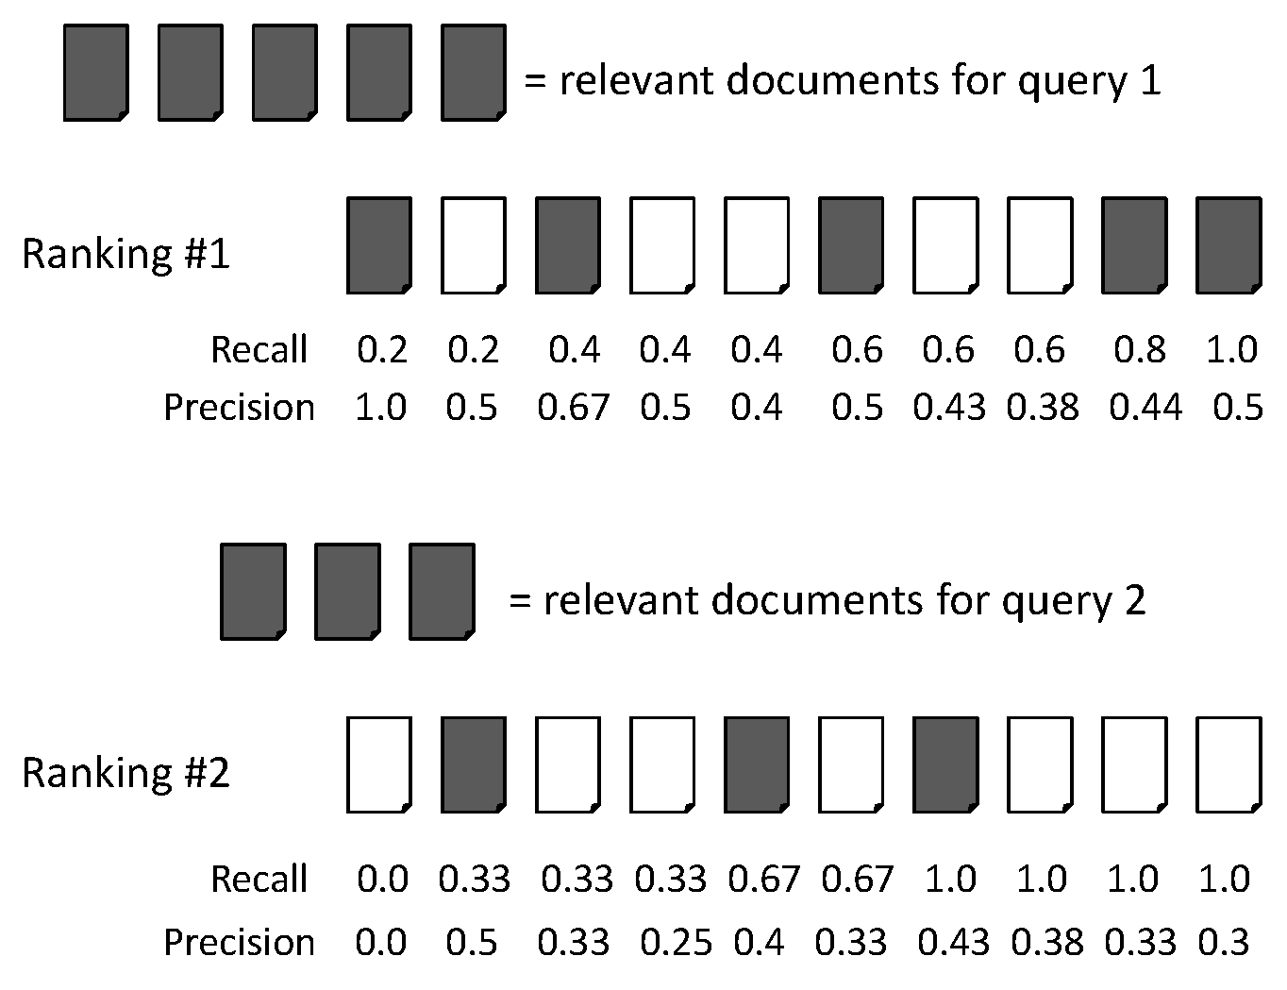
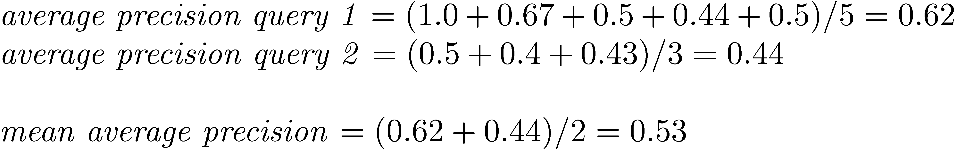
Mean Average Precision (MAP)

Slide 29
Mean Average Precision (MAP)
Summarize rankings from multiple queries by averaging average precision
Most commonly used measure in research papers
Assumes user is interested in finding many relevant documents for each query
Requires many relevance judgments in text collection

Slide 30
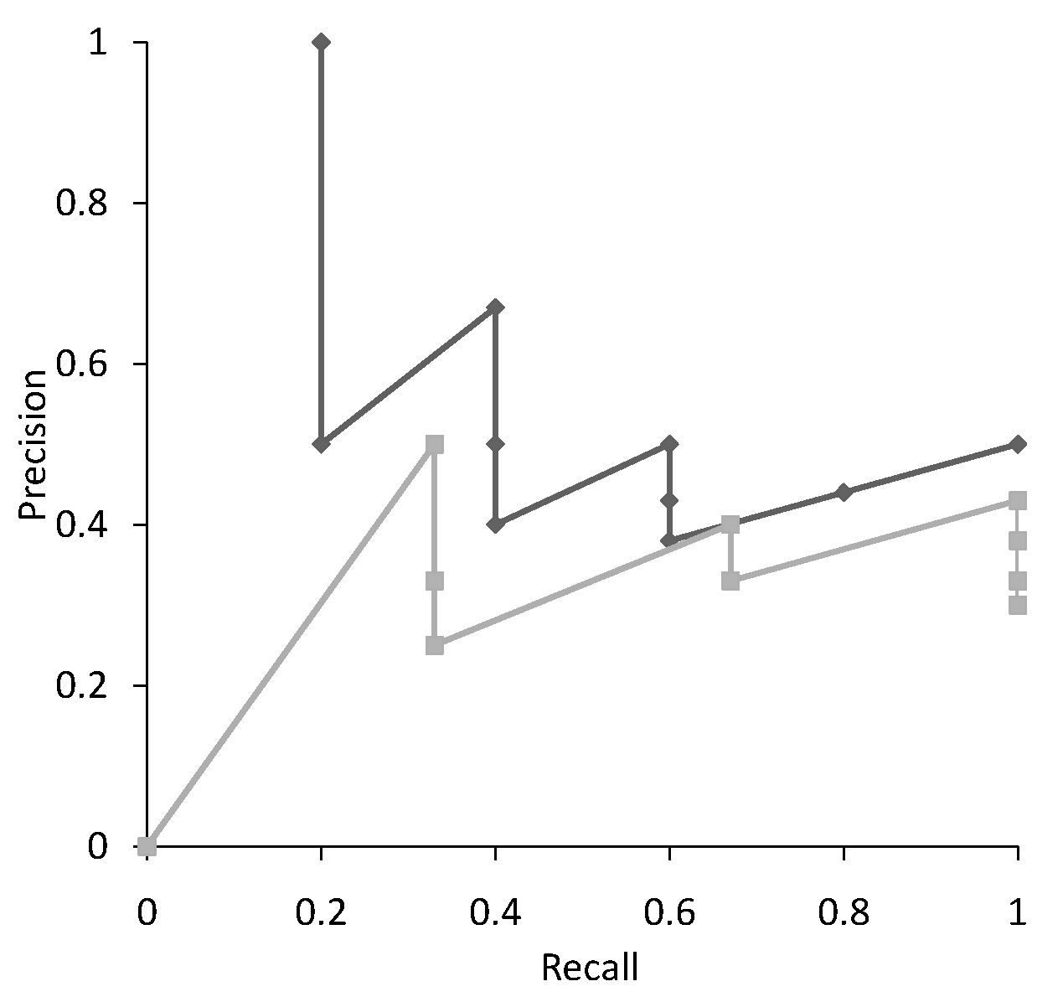
Recall-Precision Graph
Multiple precision for some recalls

Slide 31
Interpolation
  where S is the set of observed (R,P) points
Defines precision at any recall level as the maximum precision observed in any recall-precision point at a higher recall level
  produces a step function
  defines precision at recall 0.0

Slide 32
Interpolation
Recall
Interpolated
Precision
0.0 0.1 0.2 0.3 0.4 0.5 0.6 0.7 0.8 0.9 1.0
1.0

Slide 33
Interpolation
Recall
Interpolated
Precision
0.0 0.1 0.2 0.3 0.4 0.5 0.6 0.7 0.8 0.9 1.0
1.0

Slide 34
Interpolation
Recall
Interpolated
Precision
0.0 0.1 0.2 0.3 0.4 0.5 0.6 0.7 0.8 0.9 1.0
1.0 1.0

Slide 35
Interpolation
Recall
Interpolated
Precision
0.0 0.1 0.2 0.3 0.4 0.5 0.6 0.7 0.8 0.9 1.0
1.0 1.0 1.0

Slide 36
Interpolation
Recall
Interpolated
Precision
0.0 0.1 0.2 0.3 0.4 0.5 0.6 0.7 0.8 0.9 1.0
1.0 1.0 1.0

Slide 37
Interpolation
Recall
Interpolated
Precision
0.0 0.1 0.2 0.3 0.4 0.5 0.6 0.7 0.8 0.9 1.0
1.0 1.0 1.0 0.67

Slide 38
Interpolation
Recall
Interpolated
Precision
0.0 0.1 0.2 0.3 0.4 0.5 0.6 0.7 0.8 0.9 1.0
1.0 1.0 1.0 0.67 0.67 0.5 0.5 0.5 0.5 0.5 0.5

Slide 39
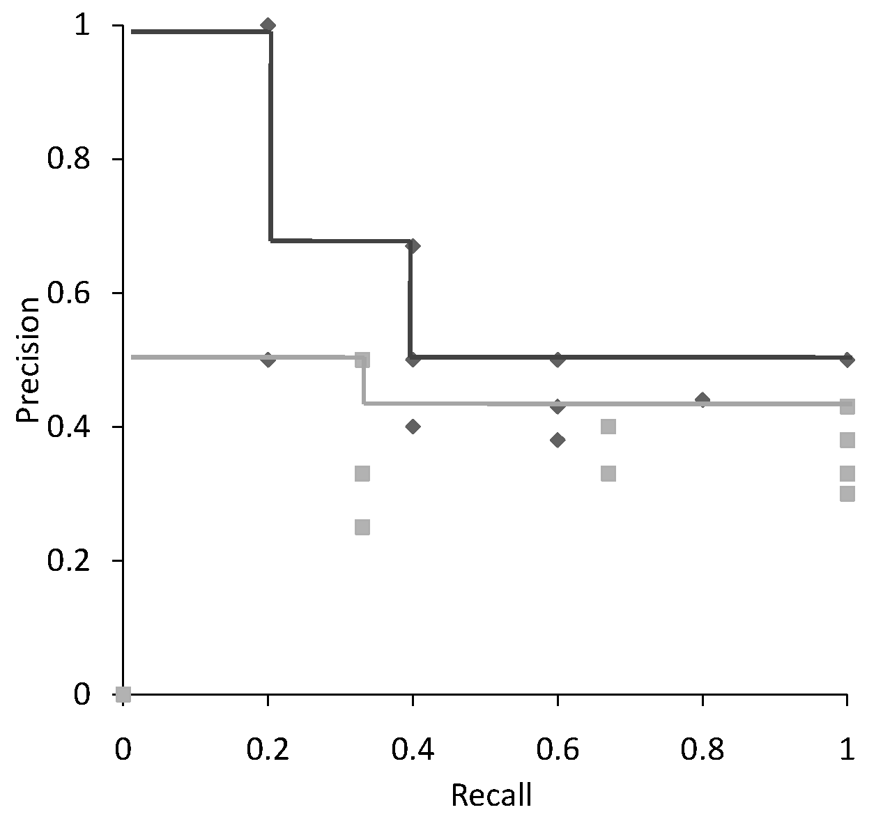
Interpolation

Slide 40
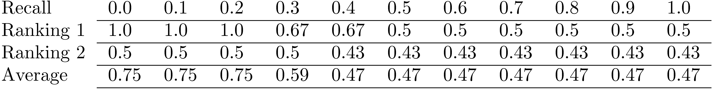
Average Precision at
Standard Recall Levels
Only consider standard recall levels: varying from 0.0
to 1.0 at the incremental of 0.1
Recall-precision graph plotted by simply joining the
average precision points at the standard recall levels

Slide 41
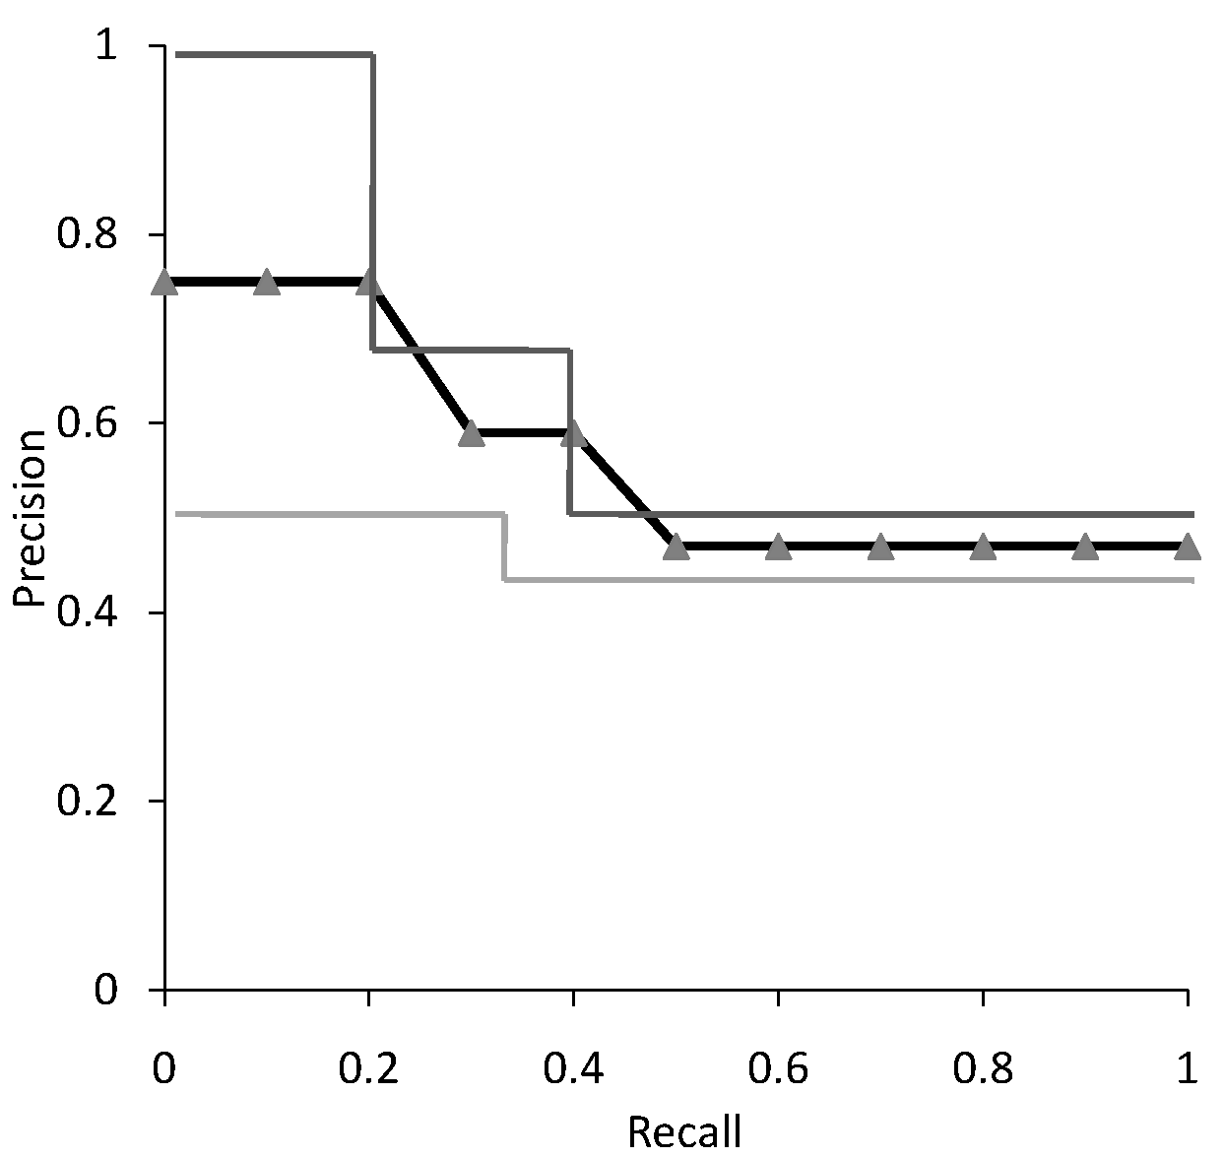
Average Recall-Precision Graph

Slide 42
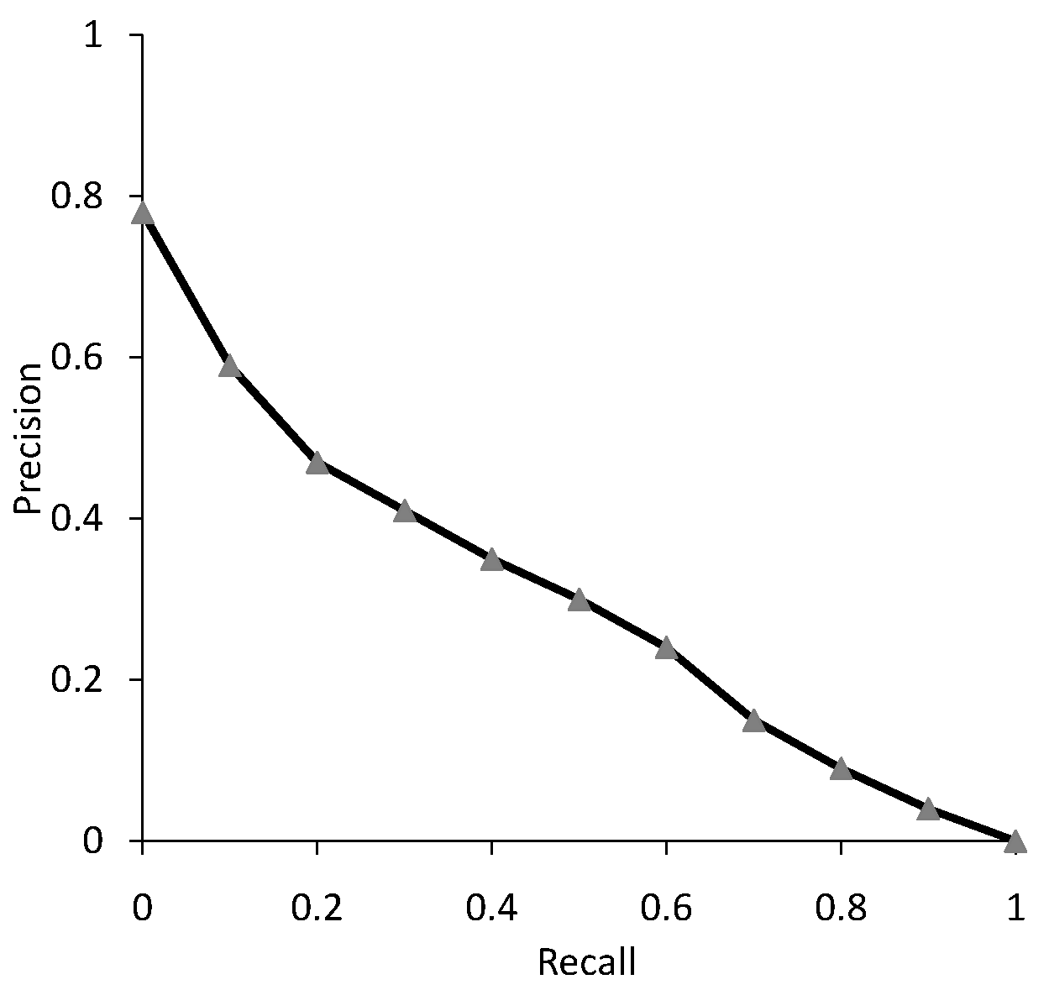
Graph for 50 Queries

Slide 43
Focusing on Top Documents
Users tend to look at only the top part of the ranked result list to find relevant documents
Some search tasks have only one relevant document
  e.g., navigational search, question answering
Recall not appropriate
  instead need to measure how well the search engine does at retrieving relevant documents at very high ranks

Slide 44
Focusing on Top Documents
Precision at Rank R
  R typically 5, 10, 20
  easy to compute, average, understand
  not sensitive to rank positions less than R
Reciprocal Rank
  reciprocal of the rank at which the first relevant document is retrieved
  Mean Reciprocal Rank (MRR) is the average of the reciprocal ranks over a set of queries
  very sensitive to rank position

Slide 45
MRR
RR = 1/1 = 1
RR = 1/2 = 0.5
MRR = (1+0.5)/2 = 0.75

Slide 46
Discounted Cumulative Gain (DCG)
Popular measure for evaluating web search and related tasks
  Use graded relevance
Two assumptions:
  Highly relevant documents are more useful than marginally relevant document
  the lower the ranked position of a relevant document, the less useful it is for the user, since it is less likely to be examined

Slide 47
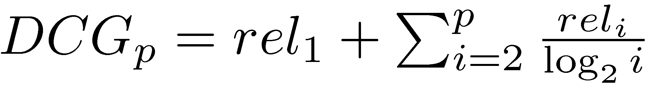
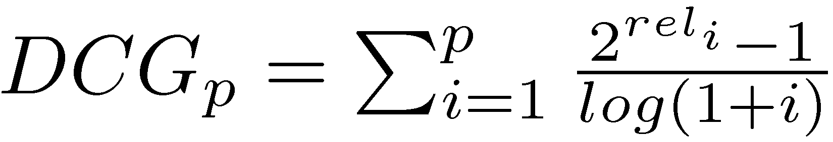
Discounted Cumulative Gain
Gain is accumulated starting at the top of the ranking and is discounted at lower ranks
  Typical discount is 1/log (rank)
  With base 2, the discount at rank 4 is 1/2, and at rank 8 it is 1/3

Slide 48
DCG Example
10 ranked documents judged on 0-3 relevance scale:
  3, 2, 3, 0, 0, 1, 2, 2, 3, 0
discounted gain:
  3, 2/1, 3/1.59, 0, 0, 1/2.59, 2/2.81, 2/3, 3/3.17, 0
  = 3, 2, 1.89, 0, 0, 0.39, 0.71, 0.67, 0.95, 0
DCG:
  3, 5, 6.89, 6.89, 6.89, 7.28, 7.99, 8.66, 9.61, 9.61

Slide 49
Efficiency Metrics
Query throughput
  The number of queries processed per second
Query latency
  The time between issuing a query and receiving a response, measured in millisecond
  Users consider instantaneous if the latency is less than 150 millisecond
Relation between query throughput and latency
  High throughput → handle multiple queries simultaneously → high latency

Slide 50
Significance Tests
Given the results from a number of queries, how can we conclude that ranking algorithm A is better than algorithm B?
A significance test
  null hypothesis: no difference between A and B
  alternative hypothesis: B is better than A
  the power of a test is the probability that the test will reject the null hypothesis correctly
  increasing the number of queries in the experiment also increases power of test

Slide 51
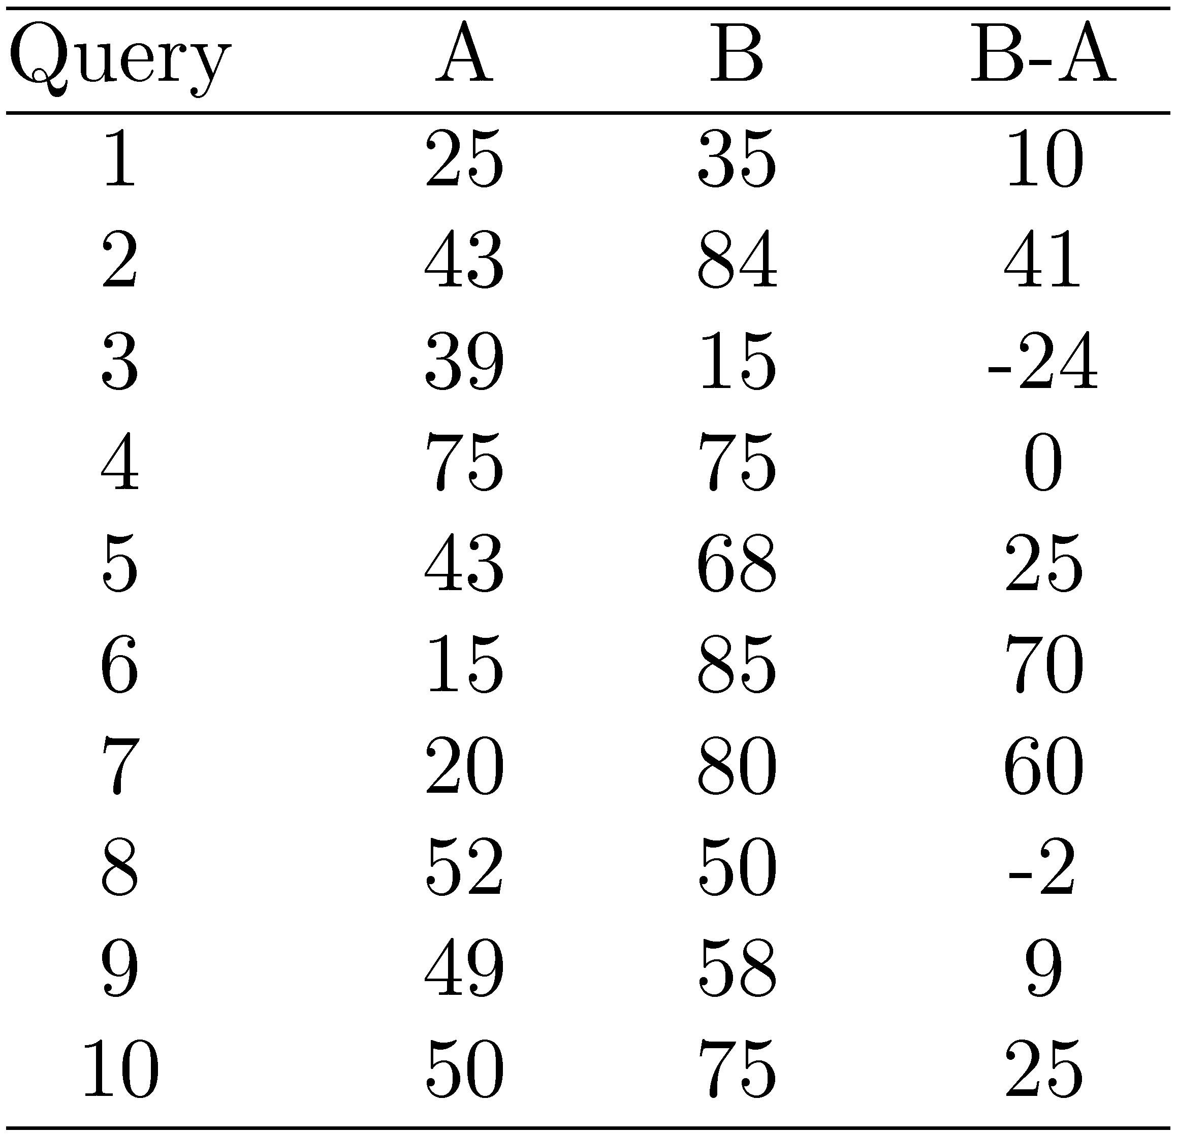
Example Experimental Results
Significance level: α = 0.05
Probability for B=A

Slide 52
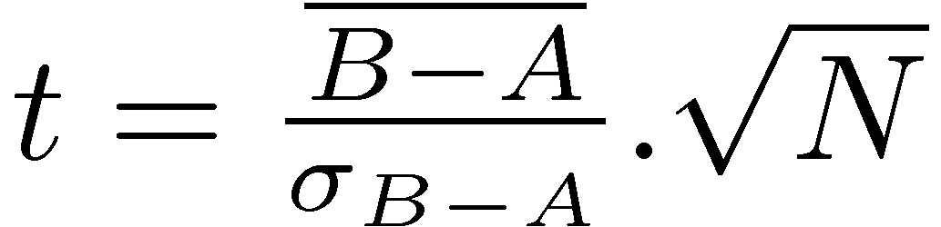
Example Experimental Results
t-test
t = 2.33 p-value = 0.02
Probability for B=A is 0.02
→ B is better than A
Avg 41.1 62.5
Significance level: α = 0.05
Probability for B=A

Slide 53
Online Testing
Test (or even train) using live traffic on a search engine
Benefits:
  real users, less biased, large amounts of test data
Drawbacks:
  noisy data, can degrade user experience
Often done on small proportion (1-5%) of live traffic

Slide 54
Summary
No single measure is the correct one for any application
  choose measures appropriate for task
  use a combination
  shows different aspects of the system effectiveness
Use significance tests (t-test)
Analyze performance of individual queries

